Slide 1

Design Pattern
Search
Composite
Truong Dang Minh Khue

Slide 2
Definition
Compose objects into tree structures to represent part-whole hierarchies.
Composite Pattern

Slide 3

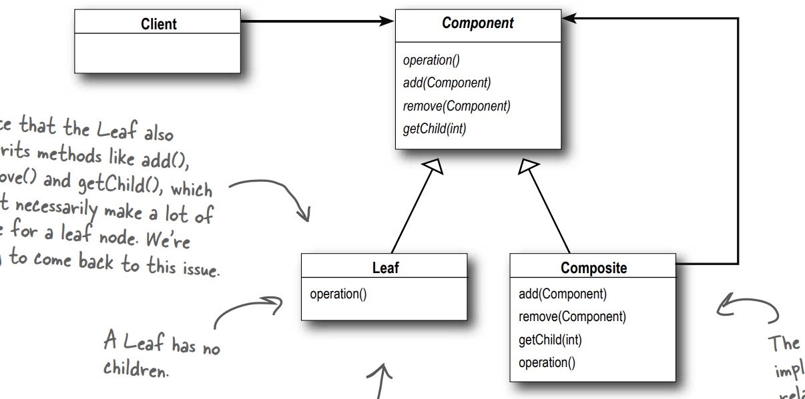


Slide 4
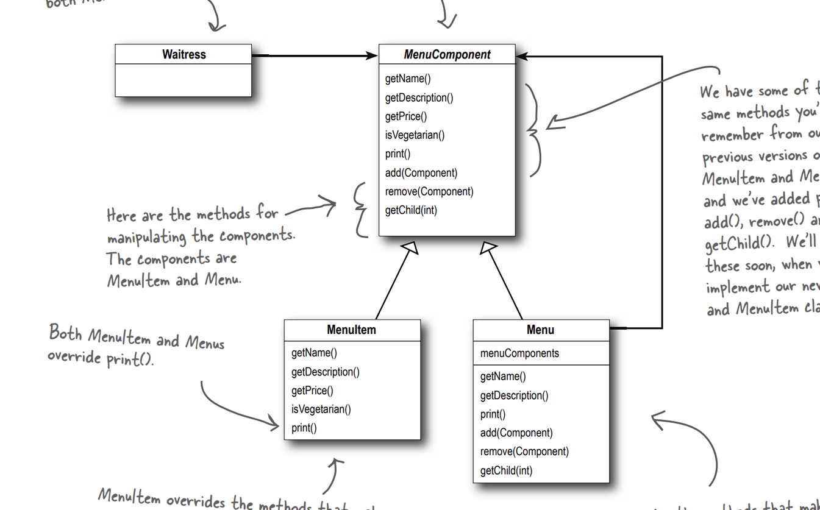

Slide 5
Thank you!
Until our next design pattern!

